Slide 1

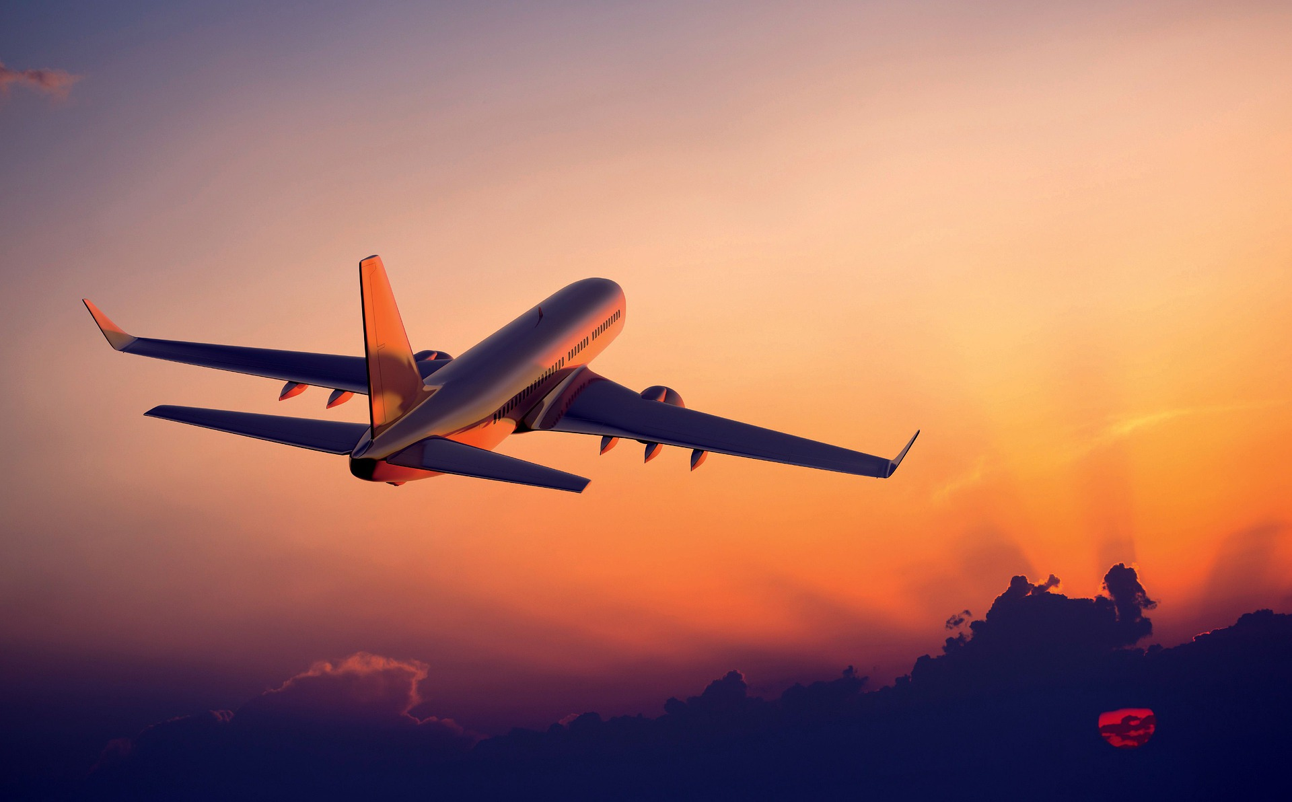
Background source: https://pixabay.com/photos/airplane-sky-sunrise-sunset-6074629/
Focusing on Safety Concerns
in the Aerospace Industry
An in-depth analysis of flight records, airline history, and
public sentiment
April 2021
Inspired by: https://www2.deloitte.com/content/dam/Deloitte/de/Documents/energy-resources/IPuC_COVID-19_Impact_on_Aerospace_industry.pdf

Slide 2
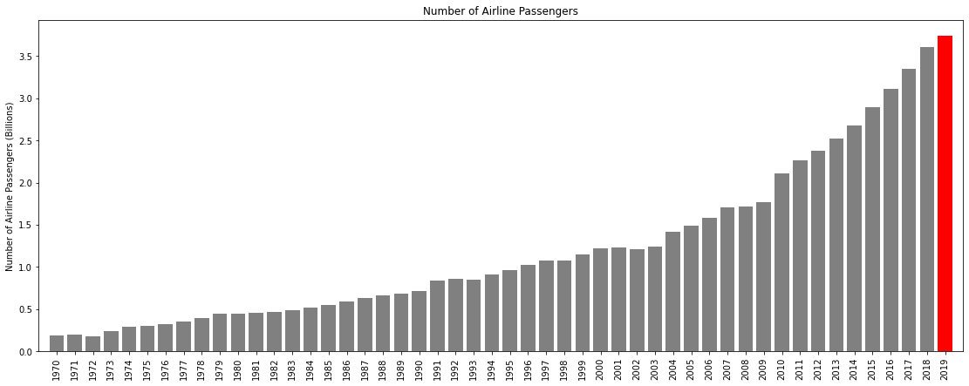
How prevalent is air travel?
In 2019, commercial airlines were responsible for transporting 3.7 billion people, almost half of the world's total population. Growth in the number of flights and passengers continue to grow exponentially each year, indicating no slowdown or disruption to the industry
Number of passengers flown dataset: https://data.worldbank.org/indicator/IS.AIR.PSGR

Slide 3
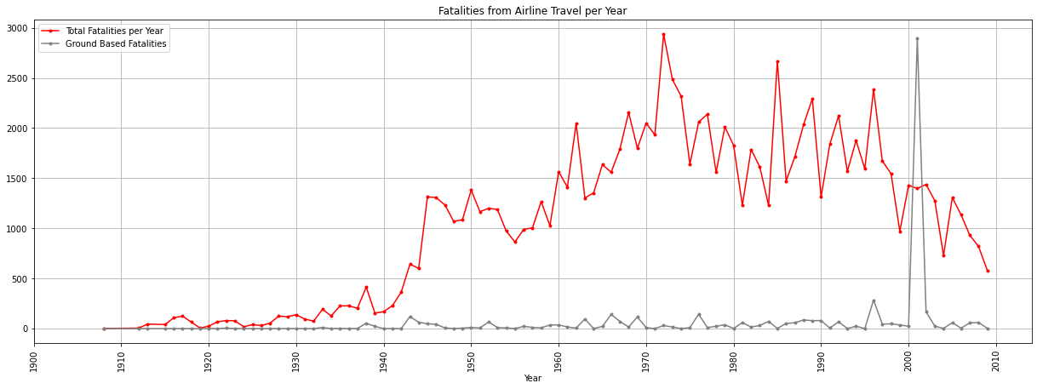
Are incidents on the rise? Not exactly.
Despite the increase of flights and passengers and the current rhetoric of airline travel being unsafe, the number of fatalities and incidences have been going down in recent years. Improvements in preventive maintenance as well as modernizing flight technology have allowed airlines to remain the safest form of travel
https://data.worldbank.org/indicator/IS.AIR.PSGR

Slide 4
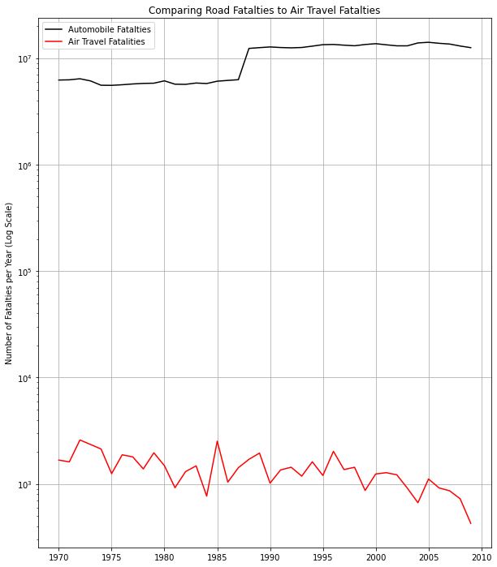
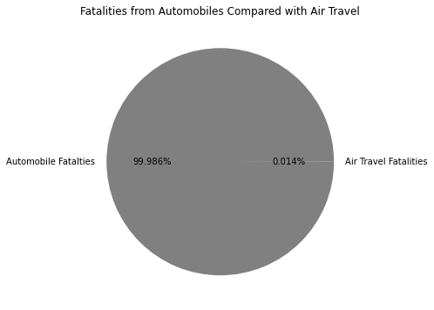
Flying or Driving? Which is Safer?
Every year, approximately 1.35 million people die from vehicle collisions, averaging out to 3,700 fatalities per day
For comparison, the worst year for airline fatalities (1972) totaled 2937 casualties.
These statistics prove that air travel is over 10,000 times safer than driving
https://data.oecd.org/transport/road-accidents.htm

Slide 5
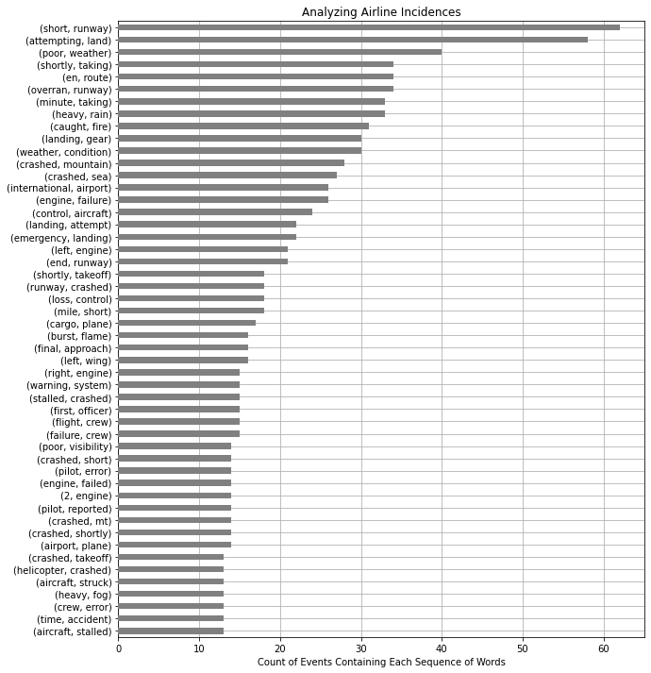
When things go wrong, what is to blame?
By analyzing the text from each of our incident summaries, we can get a general idea of each type of failure and take preventive measures to ensure fatalities are minimized
From our data, we can see that most of our incidence happen on or near the runway, implying that taking off and landing are the most dangerous parts of the trip. Ensuring landing areas are well lit and free of hazards should be our #1 priority. We can also recommend airlines provide their pilots with recurring trainings and checkups to verify their ability to fly isn’t compromised.
Weather conditions are also cited several times. Heavy rain and poor weather impact the pilot's ability to see and control the plane which can put the flight at risk. Diverting flight traffic around inclement weather is already recommended by the FAA, so early detection of these weather patterns should be a top priority.
Mechanical issues such as engine failures, landing gear errors, and loss of control are also cited in several reports. Improving preventive maintenance procedure can ensure these issues are mitigated before they become incidences.

Slide 6
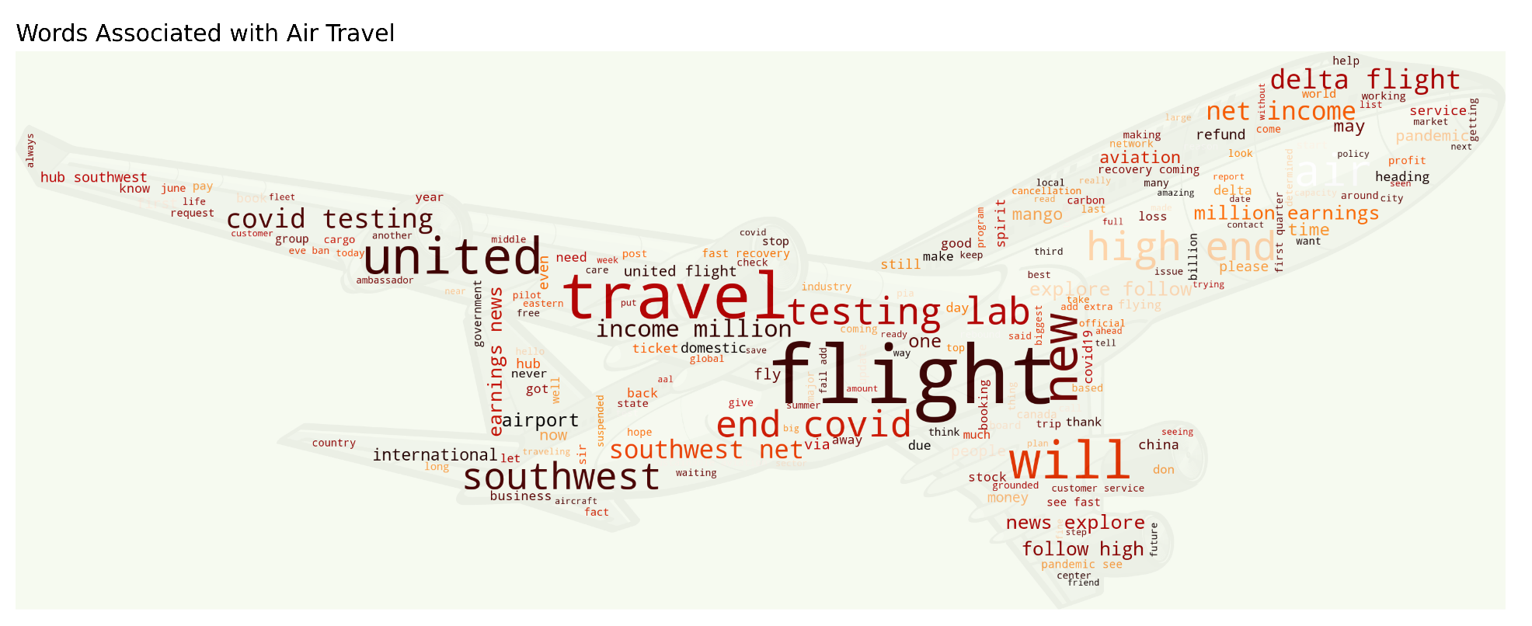
Turbulence in the Twitterverse?
Despite the recent airline crashes and media focus, the overall sentiment of air travel is positive. There are very few mentions of these incidences. Most passengers are concerned about travel risks associated with the COVID-19 pandemic

